Slide 1

CAPSTONE PROJECT HOST OPTIMAL RENT PRICE PREDICTION GROUP 7
Mentored By :
Vibha Santhanam
Submitted By :
Akash G
Gautham
Mahima V
Sai Mohan P
Sibe S

Slide 2

OVERVIEW
PROBLEM STATEMENT
The industry of hospitality and domain focuses on broad group of services that includes Lodging, transportation theme parks, cruise lines as well as additional fields inside the tourism industry. Under the lodging there are several sectors which includes hotels, motels, resorts and bed and breakfasts.
Bread and breakfasts (B&B) are like a private rooms or homes rented out by the hosts for the customers to stay in for night and a morning breakfast.
One challenge that every hosts face is determining the optimal nightly rent price. In many areas, renters aka. hosts are presented with a good selection of listings and can filter by criteria like price, number of bedrooms, room type, and more. The amount a host can charge is ultimately tied to market prices.

Slide 3
Problem Understanding
The prime challenge that hosts face is determining the optimal nightly rent price. As the industry grows higher each year, there is frequent conversion happening. With the help of existing data obtained from Airbnb dataset we can predict how the model works with business statement, optimal pricing and new feature or update added if needed.
Reactive actions so far
Currently the companies like AirBnB follows many pricing strategies to fix the prices for the listings available. The company currently uses a smart pricing tool where the pricings are based on seasonal demands, special events and daily trends. Some companies follow RevPAR (revenue per available rental ) method which considers your average daily rate (ADR) as well as your occupancy rate (OR).

Slide 4
DATASET INFORMATION
Dataset Name | Airbnb US Dataset
Number of Instances | 158249
Number of Attributes | 28
Missing Values? | Yes
Dataset Source | Kaggle
Dataset Link | https://www.kaggle.com/datasets/kavithakaruna/airbnb-us-dataset

Slide 5
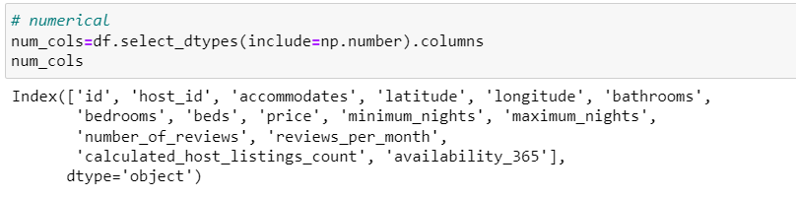
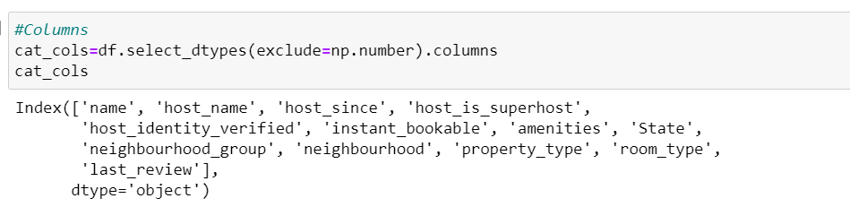
Attribute Information :
15 Numerical Columns
13 Categorical Columns

Slide 6
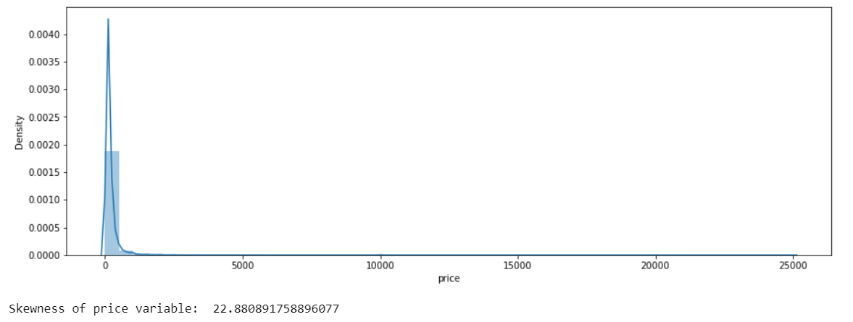
Target Variable analysis
Inference: We can see that the target column price is having a positive skewed distribution, which infers the presence of outliers in the data.

Slide 7
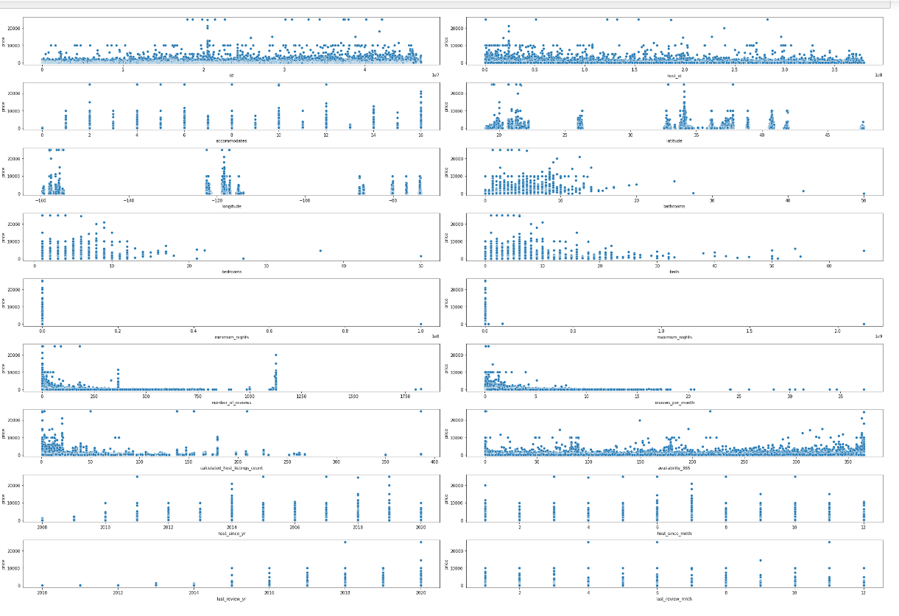
Bivariate analysis relationship between Numerical and Target variable
From the scatterplots we can see that there isn’t much relationship between the target variable price and the other numerical columns in the dataset.

Slide 8
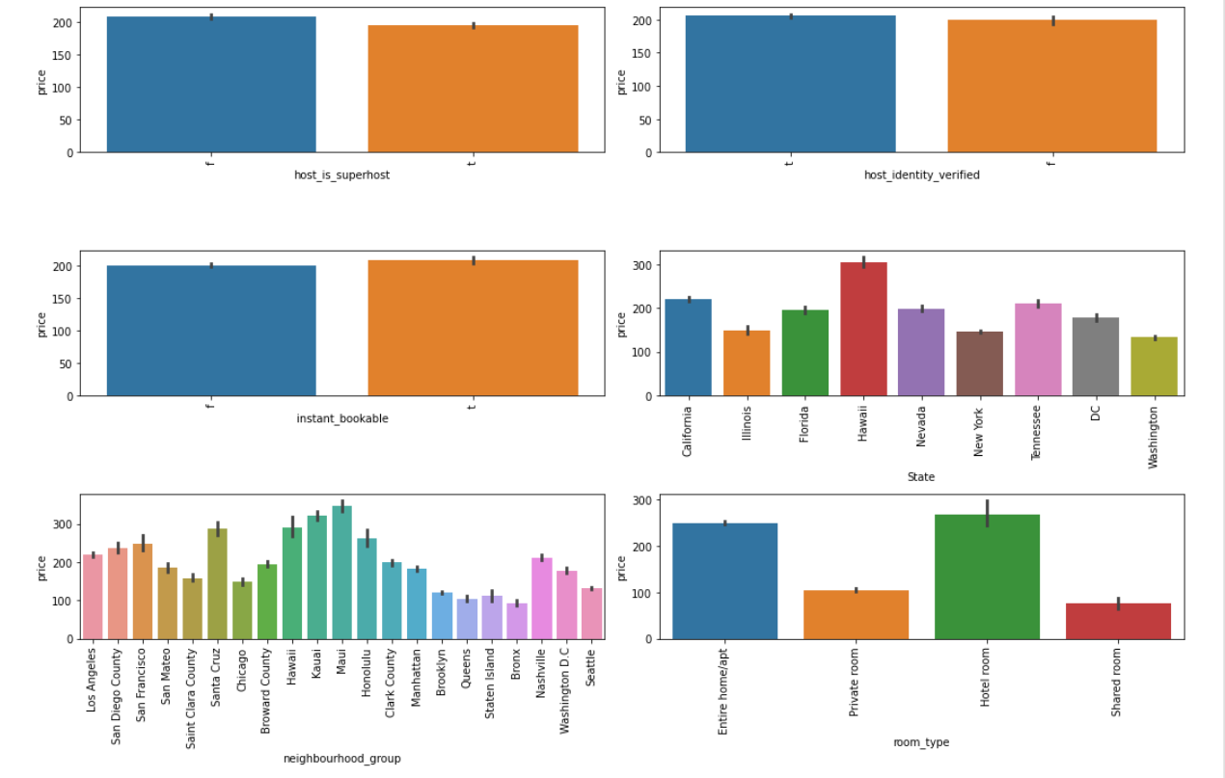
Bivariate analysis relationship between Categorical and target variable
Host_is_superhost: Average prices are almost equal for both superhosts and non-superhosts.
Host_is_verified: Average prices are almost equal for the listings which are verified and unverified.
Instant_bookable: Average prices are almost equal whether there is a availability of instant booking or not.
State: Average price in Hawaii is greater than compared to other states.
Neighbourhood_group: Average price in Maui neighbour hood group is greater than compared to others.
Room_type: Average prices in hotel rooms and Entire home/apt are almost equal and higher than the other room types.

Slide 9
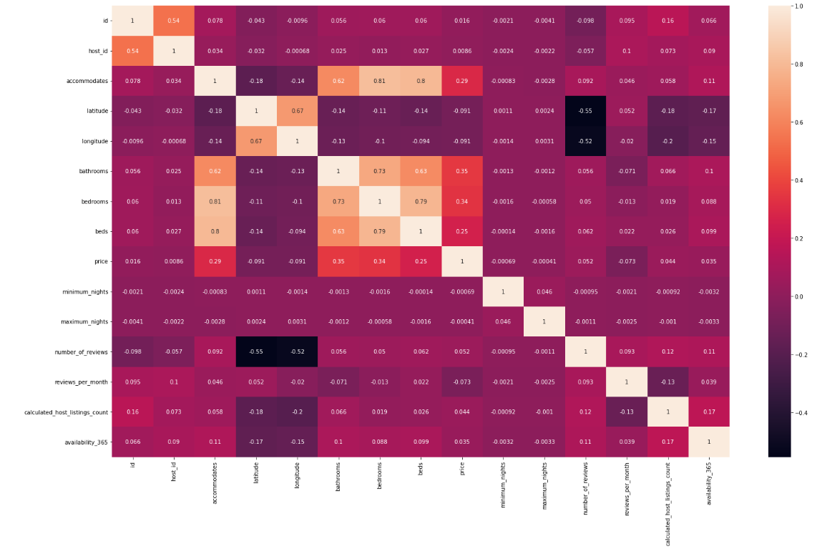
Correlation
On comparing with the target variable there isn’t much correlation between the variables.
But there is multi collinearity is present between the columns accommodates , beds, bathroom and bedrooms
Also multi-collinearity between host id and Host since year
Latitude and Longitude has moderately strong multi collinearity between them.

Slide 10
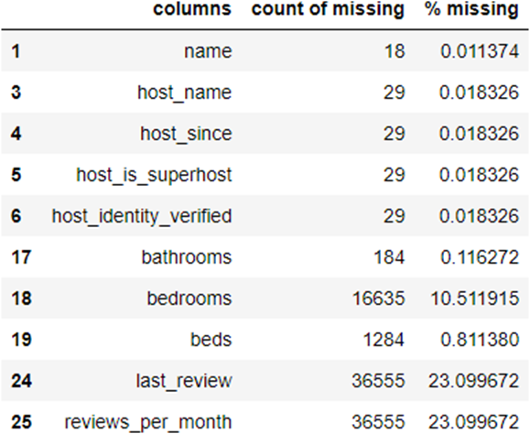
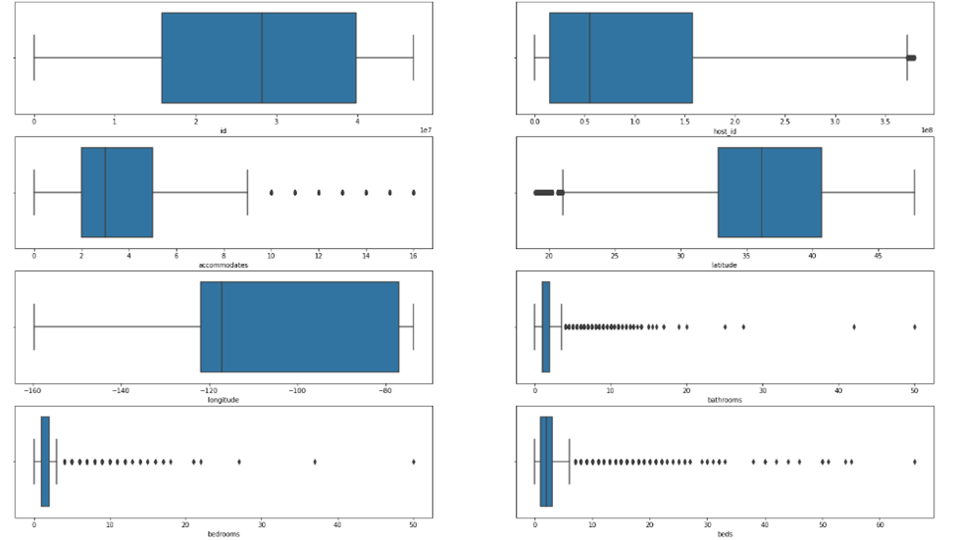
Missing Values
The null values in the name, host_name columns are imputed as “Unknown”.
The reviews_per_month null values are imputed with 0 .
The host_is_superhost, host_identity_verified columns are imputed with ‘f’ (false).
The null values for bathrooms and bedrooms are filled based on the number of accommodates the particular listing can occupy.
The null values for beds are filled with respect to the number of bedrooms in the particular listings.
Outliers
Since there are more number of outliers present in the dataset we can’t afford to lose all those data. So we are performing transformation to reduce the outliers in the data set.
We are performing yeo-johnson transformation since there are presence of all numerical continuous variables like positive, negative and zero values. After performing the transformation the outliers count are found to be reduced significantly.

Slide 11
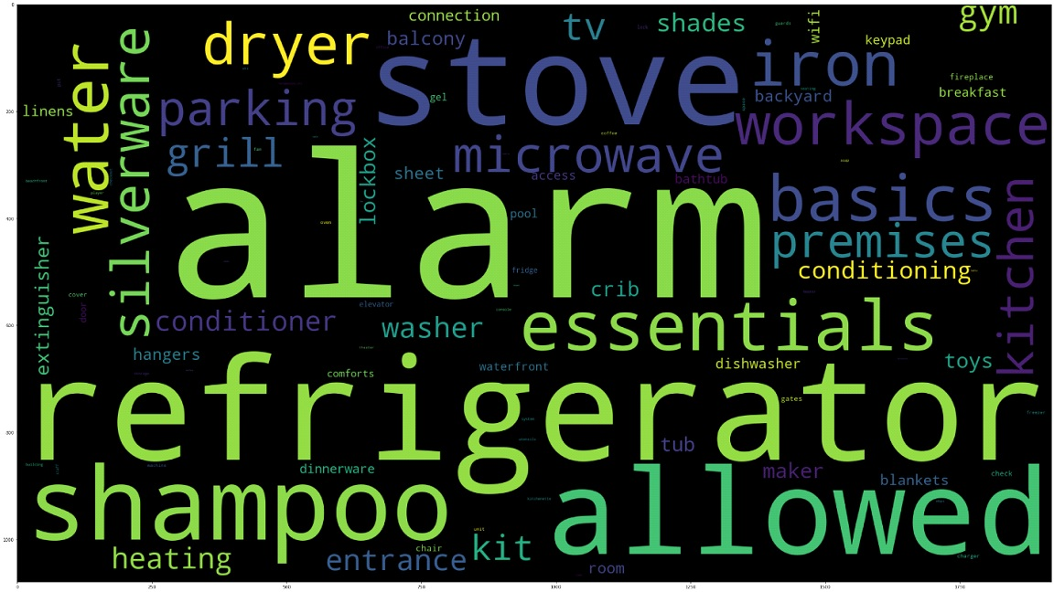
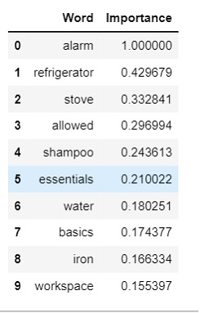
Feature Engineering
Amenities score: The top 10 words identified from the amenities

Slide 12

Feature Engineering
Regions column
Property Rate
Property Budget
Host Rank
Amenities Count
Redundant columns Removing
One Hot Encoding

Slide 13
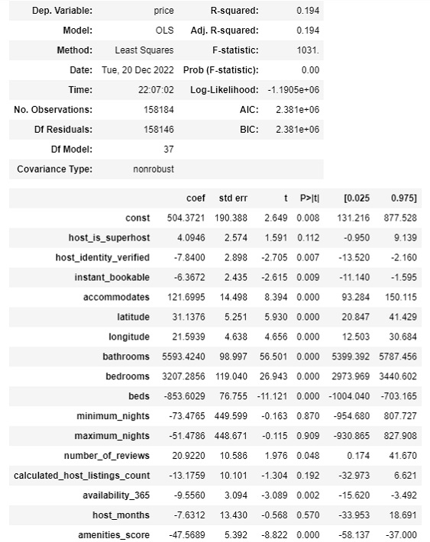
Base model -
Linear Regression
Inference:
Regression analysis is a powerful statistical method that allows you to examine the relationship between two or more variables of interest. In predictive analytics it can be used to predict a future numerical value of a variable. Linear regression is most suitable for linear data. But it’s very sensitive toward outliers in the data points. The outliers in the data can have a significant impact on the model.

Slide 14

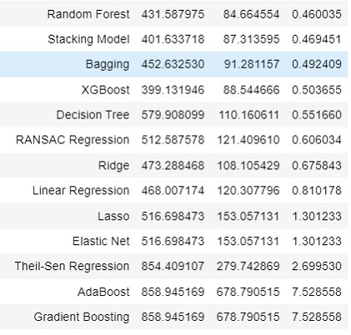
Model Metrics Comparison
Since we tend to proceed model building with outliers we prioritize the metrics MAE and MAPE.
The reason is because MAE and MAPE deal with the median score which is robust to outliers compared to RMSE which is sensitive to them.
The top three models on inferring the MAE and MAPE score are Random forest regression model, Stacking regression model and Huber regression Model.
Out of these three we found Random forest model to be promising and providing a generalized and ideal MAPE value 0.45 approx.
.

Slide 15
Random Forest Tuned:
Using Grid Search CV we passed certain parameters and identified the best parameters as follows.
max_depth: None
max_features: 0.2
min_samples_leaf: 1
min_samples_split: 2
n_estimators: 300
From the above best parameters identified we have fitted a random forest model and observed below.
Root Mean Squared Error (RMSE): 411.686
Mean Absolute Error (MAE): 80.938
Mean Absolute Percentage Error (MAPE): 0.442

Slide 16
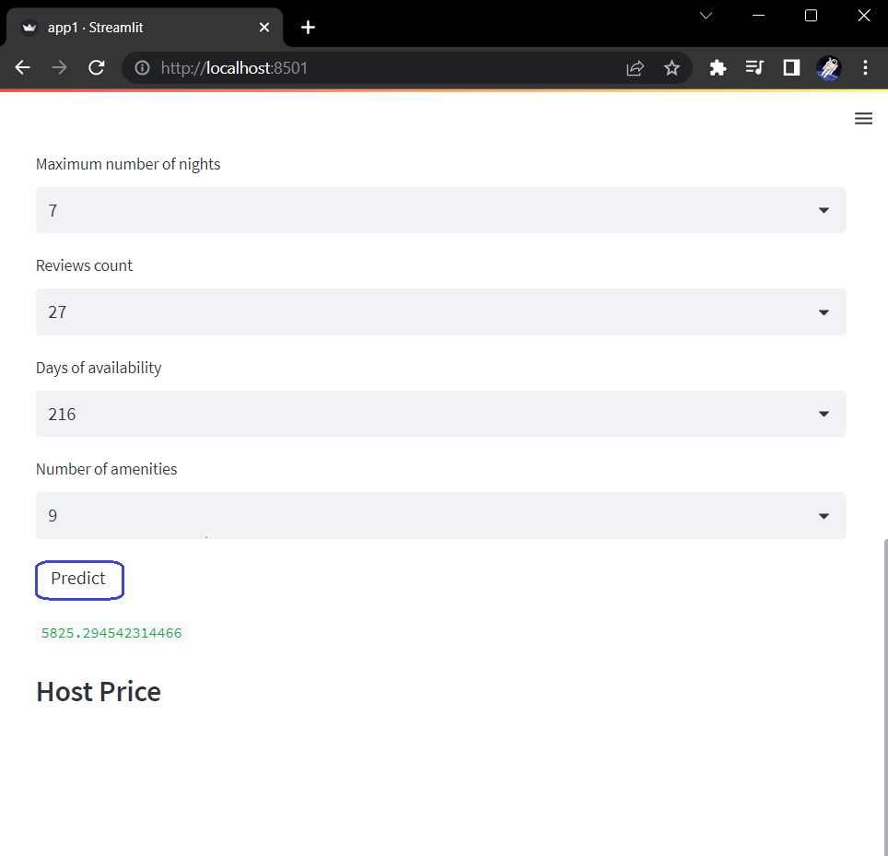
Model Deployment

Slide 17

Challenges
Understanding the Domain
Understanding the Features
Exploratory Data Analysis (which include Data Cleaning, Null value, Duplicated record, Outliers)
Finding the Best Model
Model Deployment
Conclusion
The final model that we have adopted will help predict the optimal price for the new host listings any added into the system. Although the model predicts an optimal price there is still space for improvement of the models to increase the performances.
A bunch of different variables that are not included could play an major role in increasing the performance. For example, given the importance of customer reviews of the listing in determining price, a better understanding of the reviews could very likely improve the prediction. One could use Sentiment Analysis. A score between very negative sentiment and very positive sentiment can be assigned to each review per listing property. The scores are then averaged across all the reviews associated with that listing and the final scores can be included as a new feature.
We could also include image quality as a feature. Using deep learning and supervised learning analyses on an Airbnb panel dataset, researchers found that units with verified photos (taken by Airbnb’s photographers) generate additional revenue per year on average. So adding Image features may provide an increased advantage in the price prediction.

Slide 18



